Slide 1

Lab 09
FIT5202 Big Data Processing
Collaborative Filtering using ALS

Slide 2
Lab 09 Agenda
•
Lab 08 Review
•
K-means clustering
•
Model Selection
•
Model Persistence
•
Collaborative Filtering
•
Use case : Music Recommendation

Slide 3
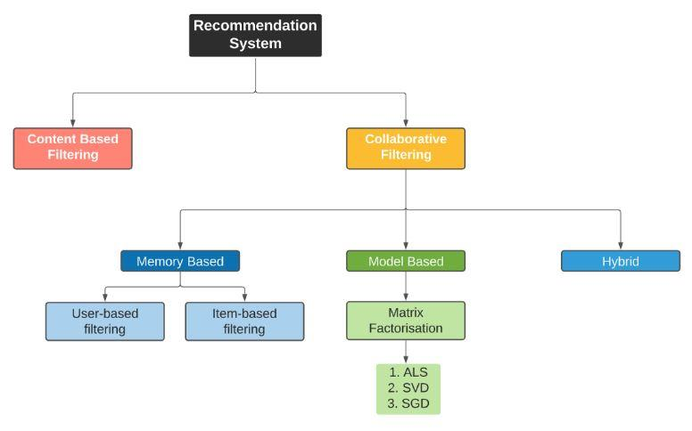
Recommender Approaches
Notes:
Because content-based filtering only recommends items based on a user’s previously evidenced interests, its recommendations are often similar to items a user liked in the past. In other words, CBRSs lack a methodology for exploring the new and unpredicted. This is overspecialization. In contrast, because collaborative-based methods draw recommendations from a pool of users who have similar likes to one given user, they can often recommend items that a user may have not considered, appears with different features than a user’s previously liked items but that retain a some unrepresented element that appeals to a user type

Slide 4
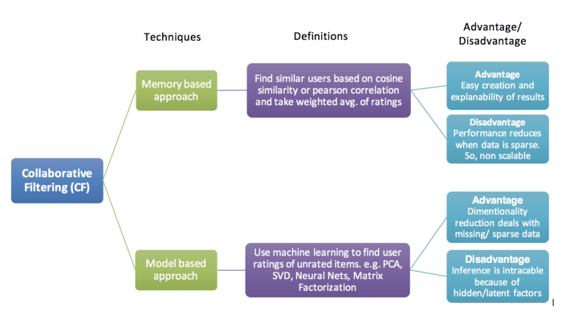
Recommender Approaches
https://towardsdatascience.com/various-implementations-of-collaborative-filtering-100385c6dfe0

Slide 5
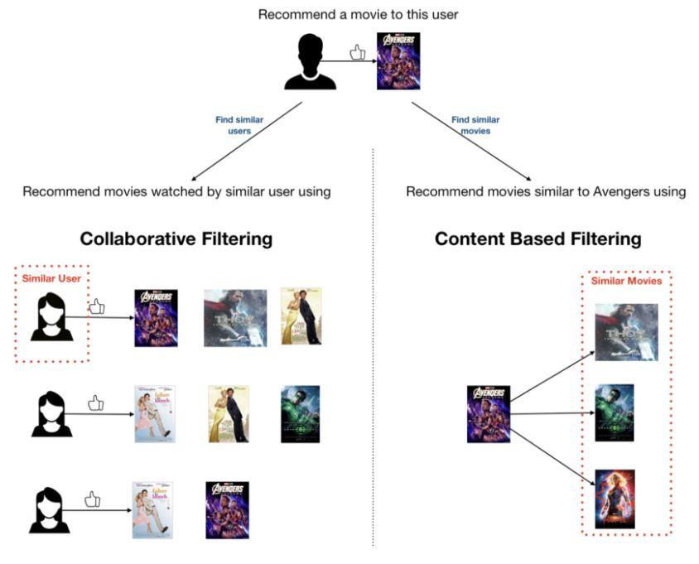

Slide 6
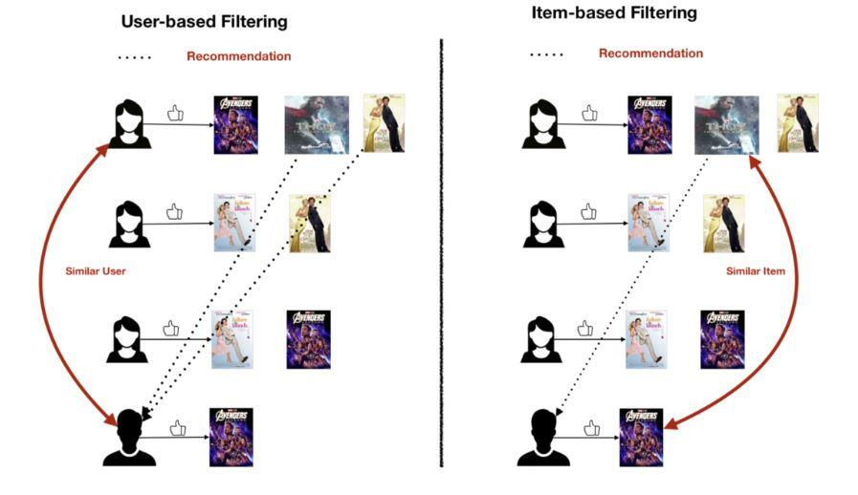
Memory-Based Approach

Slide 7
Implicit vs Explicit Feedback
•
Explicit :
•
when we have some sort of Rating (i.e. users provide items’ rating
explicitly)
•
Implicit :
•
data is gathered from user behaviour, e.g. how many times a song is played
or a movie is watched.
•
Advantage : more data
•
Disadvantage : Noisy data, negative preferences are not known
https://medium.com/radon-dev/als-implicit-collaborative-filtering-5ed653ba39fe

Slide 8
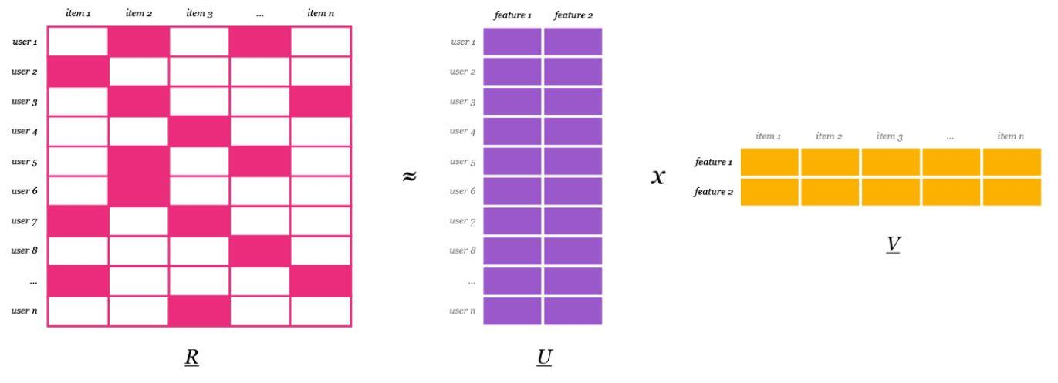
Matrix Factorization
https://medium.com/radon-dev/als-implicit-collaborative-filtering-5ed653ba39fe

Slide 9
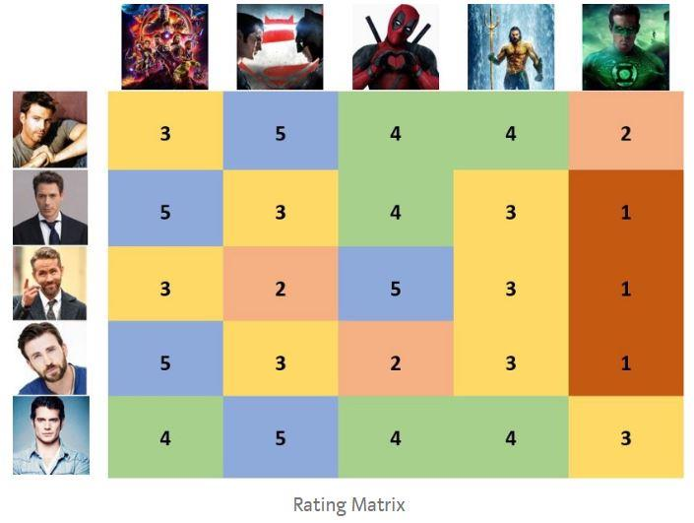
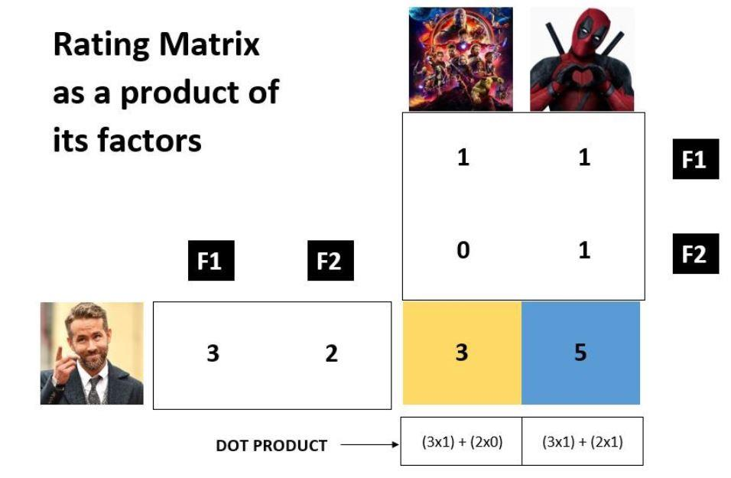
Matrix Factorization – with Explicit Rating
https://medium.com/sfu-cspmp/recommendation-systems-collaborative-filtering-using-matrix-factorization-simplified-2118f4ef2cd3

Slide 10
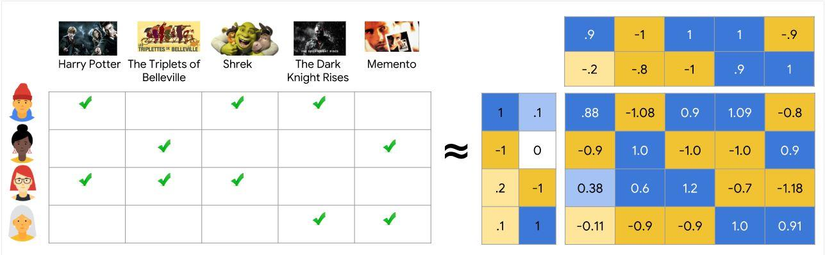
Matrix Factorization – with Implicit Feedback
https://developers.google.com/machine-learning/recommendation/collaborative/matrix

Slide 11

Alternating Least Square (ALS) – Implicit Rating
•
Confidence:
•
Quantify confidence of how much user u likes the item i of the user
from the implicit rating data r
•
Alpha
•
The rate (linear scaling) of confidence increases
•
Optimizing alternately to find U, V
•
Randomly initialize U and V
•
Iterating the following steps:
•
Fixing U
🡪
Optimizing V
•
Fixing V
🡪
Optimizing U
https://medium.com/radon-dev/als-implicit-collaborative-filtering-5ed653ba39fe

Slide 12
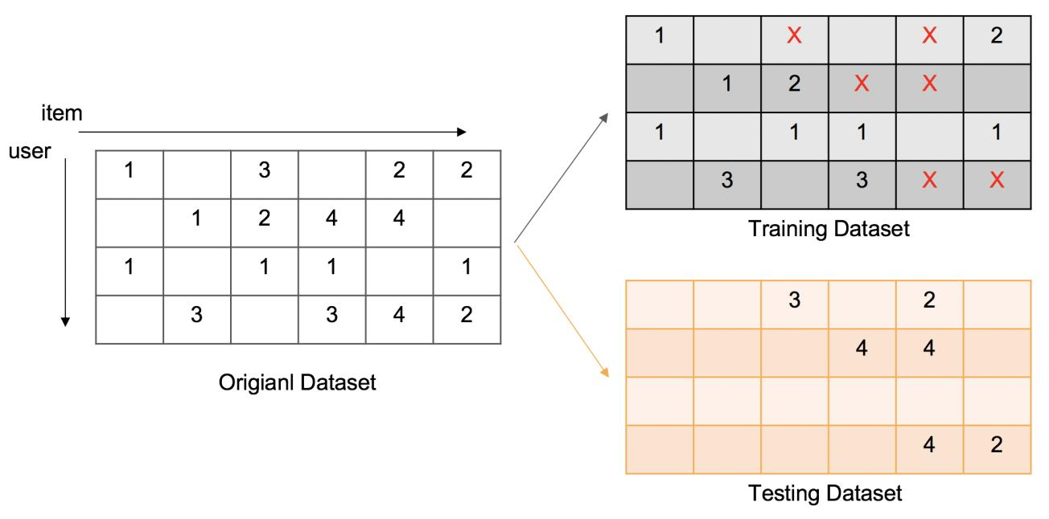
Train/Test Split
Original Dataset
https://towardsdatascience.com/recsys-implementation-on-variants-of-svd-based-recommender-system-a3dc1d059c83

Slide 13
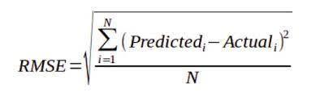
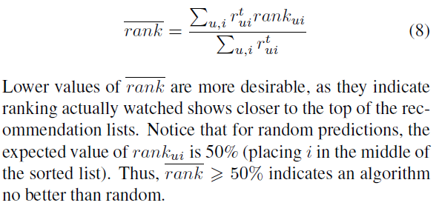
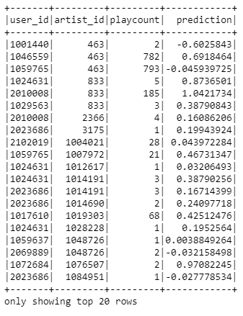
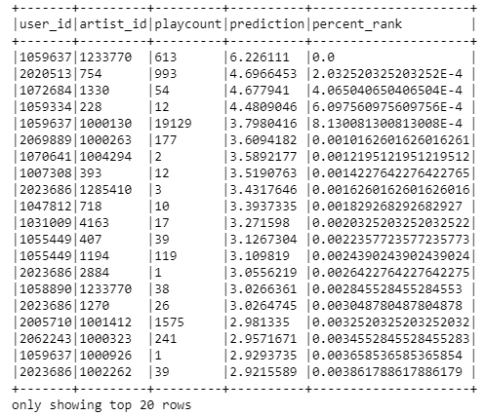
Evaluation metrics
For implicit feedback
For explicit feedback
ROEM (Rank Ordering Error Metric)
RMSE may not be appropriate for
measuring prediction for implicit feedback
ref: http://yifanhu.net/PUB/cf.pdf
From paper ‘Collaborative Filtering for Implicit Feedback Datasets’
Notes:
What it is: A rank ordering error occurs when the items in a generated list are not in the ideal order of their relevance or utility.
Why it's important: In applications like search engines or recommendation systems, the top-ranked items should be the most relevant. Errors in ranking can significantly reduce user satisfaction and the effectiveness of the system

Slide 14
Cold-Start Problem
❑ Cold-start: New users will have no to little information about them to be compared
with other users.
❑ Cold starts occur when we attempt to predict a rating for users and/or items in the
test dataset that were not present during training the model
Two strategies for handling this problem:
"NaN" - return an empty variable.
•
Spark assigns NaN predictions during ALSModel.transform when a user and/or item factor is not
present in the model.
•
In development however, this result prevents us from calculating a performance metric to
evaluate the system.
"drop" - this option simply removes the row/column from the predictions that contain NaN values.
Our result will therefore only contain valid numbers that can be used for evaluation.

Slide 15
Use Case : Music Recommendation
bad_ids
user_artist
user_id
artist_id
playcount
Recommendation
user_id,artist_id,pla
user_artist_df
123
456
12
ycount
ALS
132
654
14
Map bad_ids to
good_ids
artist_alias
artists
artists_df
Recommended
artist_ids
Artist
Recommendations
with artist_names

Slide 16
Thank You!
See you next week.

